Slide 1


Team 31: Chilly Dog
Bi-Weekly Update 2 Grant Franklin Martin Rennaker Yarentzy Magallanes Sponsor: Rohith Kumar TA: Rohith Kumar
Notes:
Michelle

Slide 2
Project Overview
Problem statement
A car parked outside on a sunny, 95-degree day can reach temperatures of up to 117 degrees Fahrenheit in just 30 minutes.
Approximately 100 dogs die in vehicles from heat exhaustion per year according to the AVMA.
Notes:
***You stop at the store just to run in for a second, and leave your pet in the car with the windows “cracked.” You’re just going to grab a couple of things, so it should all be fine. However, the lines in the store are long, you found a few extra things you needed Your pet should still be okay, though… he’s only been out there for about 20-30 minutes. Right?
Wrong.
***A car parked outside on a sunny, 95-degree Fahrenheit day can reach temperatures of up to 117 degrees Fahrenheit in just 30 minutes.
Your quick trip to the grocery store could be the determining factor between your pets life or death.
**approximatley 100 dogs die from heat exhaustion a year according to the American Veterinary Medical Association.

Slide 3
Solution
Provide ideal cabin conditions to allow your pet to safely stay unattended in a vehicle.
Features:
Does not rely on the battery or motor of your vehicle
Receive real time ambient and cabin temperature readings
Set a desired cabin temperature through the Chilly dog phone application
Receive alerts for low battery and extreme temperature conditions
Notes:
***We, the chilly dogs, have created a device to keep your cabin cool while you are away and assure the safety of your pet.
***The chilly dog is a battery powered car A/C system. that can cool the inside of your vehicle without relying on the motor of your car or its battery.
***Chilly Dog users will be able to receive real time temperature reading of the ambient and cabin temperature, adjust the desired output temperature using the chilly dog phone application, and even receive alerts when the device has low battery or conditions in the cabin become unfit for the pet.

Slide 4
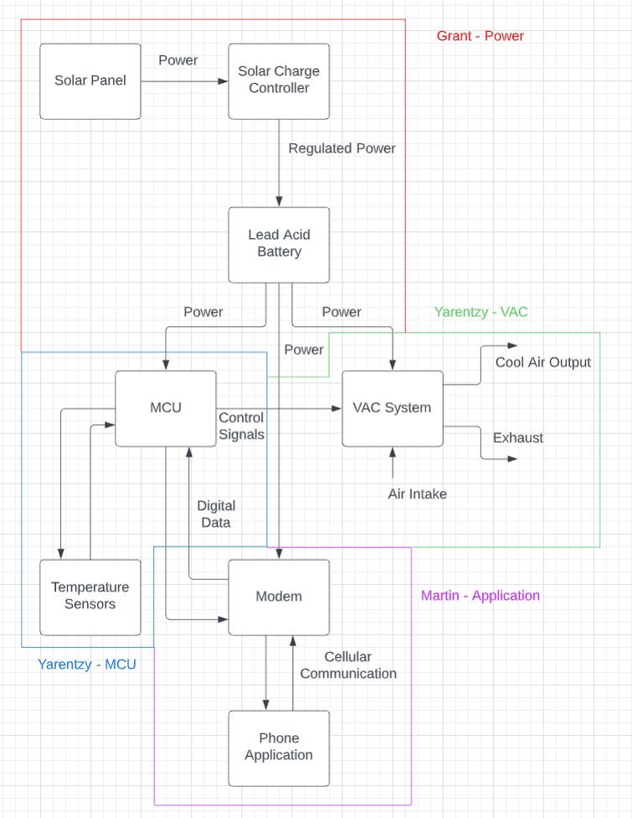
Project/Subsystem Overview

Slide 5
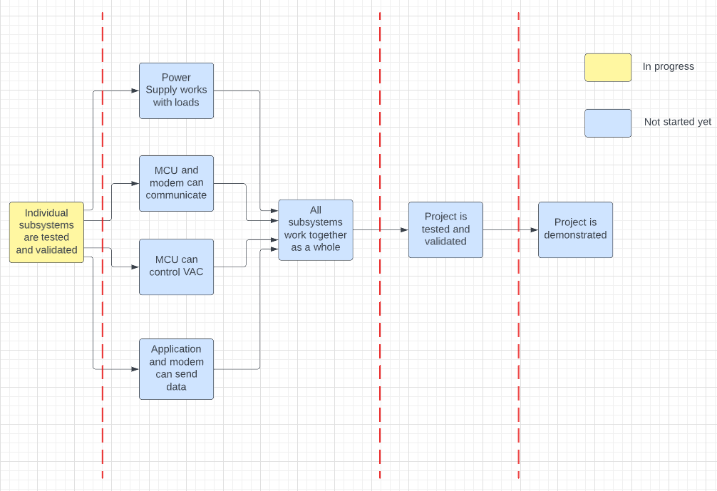
Project Timeline
8/28-9/9
9/10-10/28
10/29-11/30
12/1-12/2

Slide 6
Power Subsystem
Grant Franklin
Accomplishments since last presentation | Ongoing progress
Designed and ordered Power Supply PCB Designed and ordered Buck and battery life circuits Validated functionality of buck and battery life circuits on Perfboard Validated battery-VAC functionality | Perform line/load regulation tests Validate functionality of circuits with real loads with power supply input Validate solar charging capability Solder and test circuits on FEDC PCB Design and order final PCB with all subsystem components

Slide 7
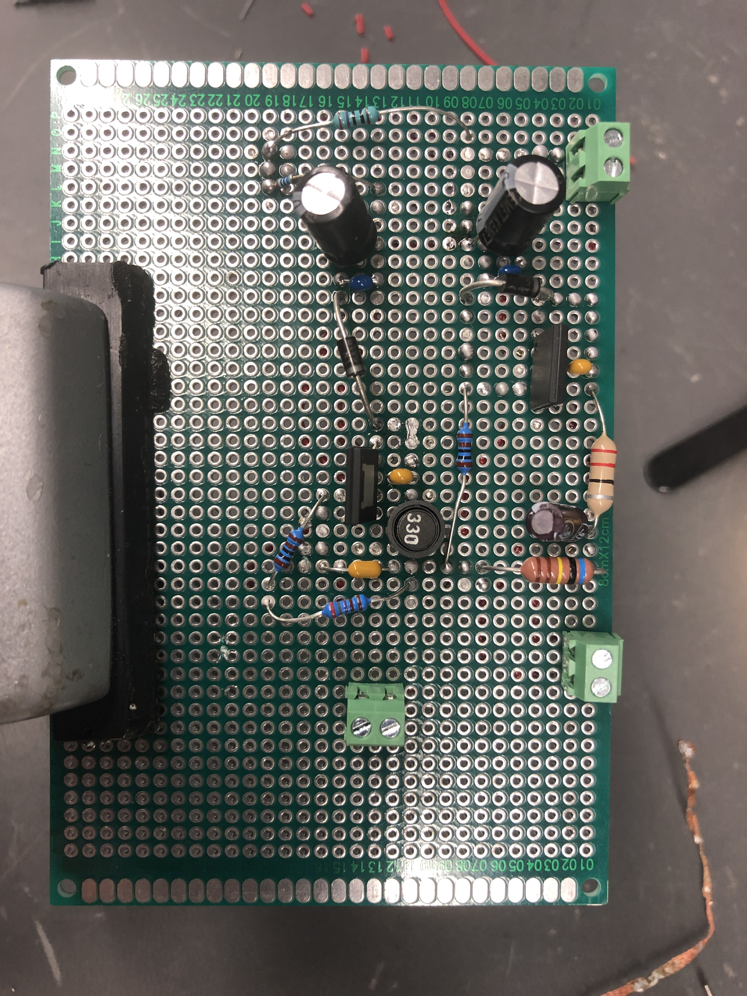
Power Subsystem
Grant Franklin
MCU Buck –
Simulation Output: 9.05V
Tested Output: 8.991V
Modem Buck –
Simulation Output: 4.97V
Tested Output: 4.986V

Slide 8
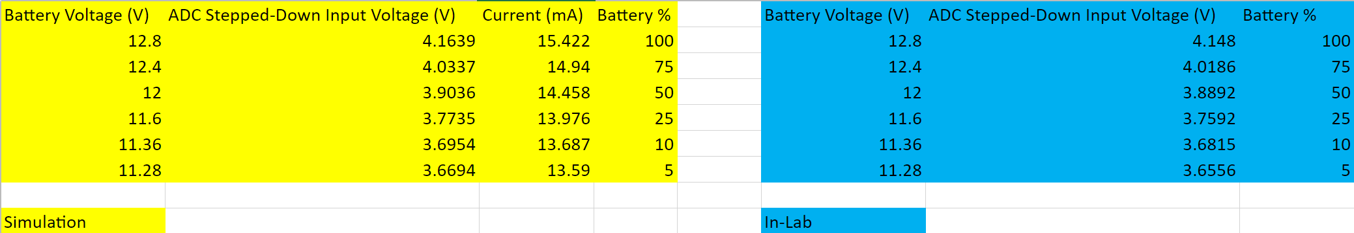
Power Subsystem
Grant Franklin

Slide 9
MCU Subsystem
Yarentzy Magallanes
Accomplishments since last presentation | Ongoing progress
Received Arduino Mega Received temperature sensors with improved accuracy Completed coding to read temperature sensor data every minute Tested both internal and external sensors for accuracy and errors in outputs | Establish communication with modem to send and receive temperature setpoints and outputs

Slide 10
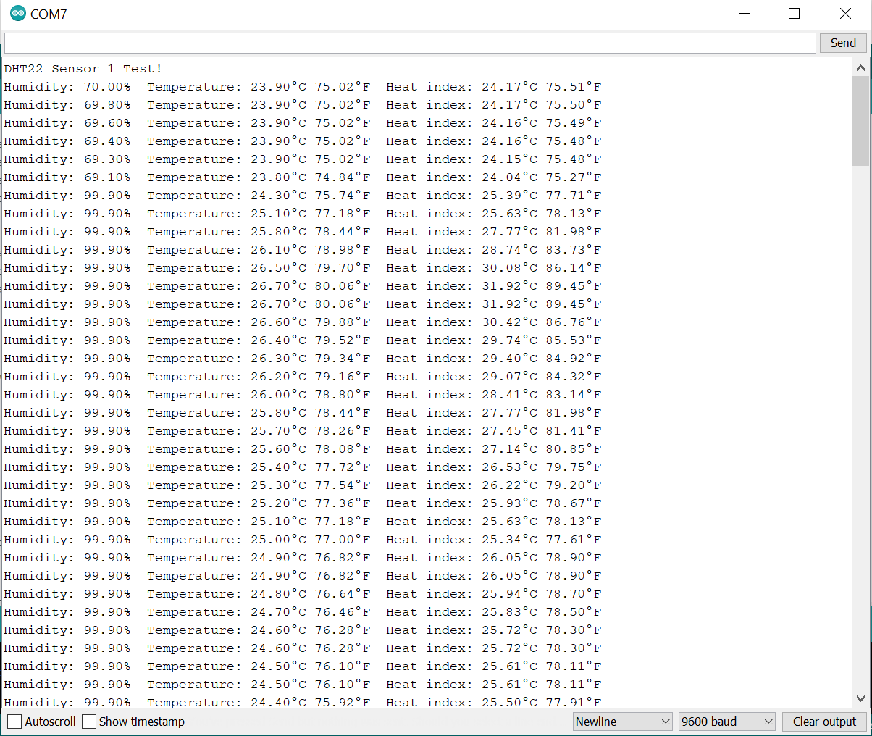

Testing Sensor 1
Ambient Temperature
Begin blowing hot air
Stop blowing hot air

Slide 11
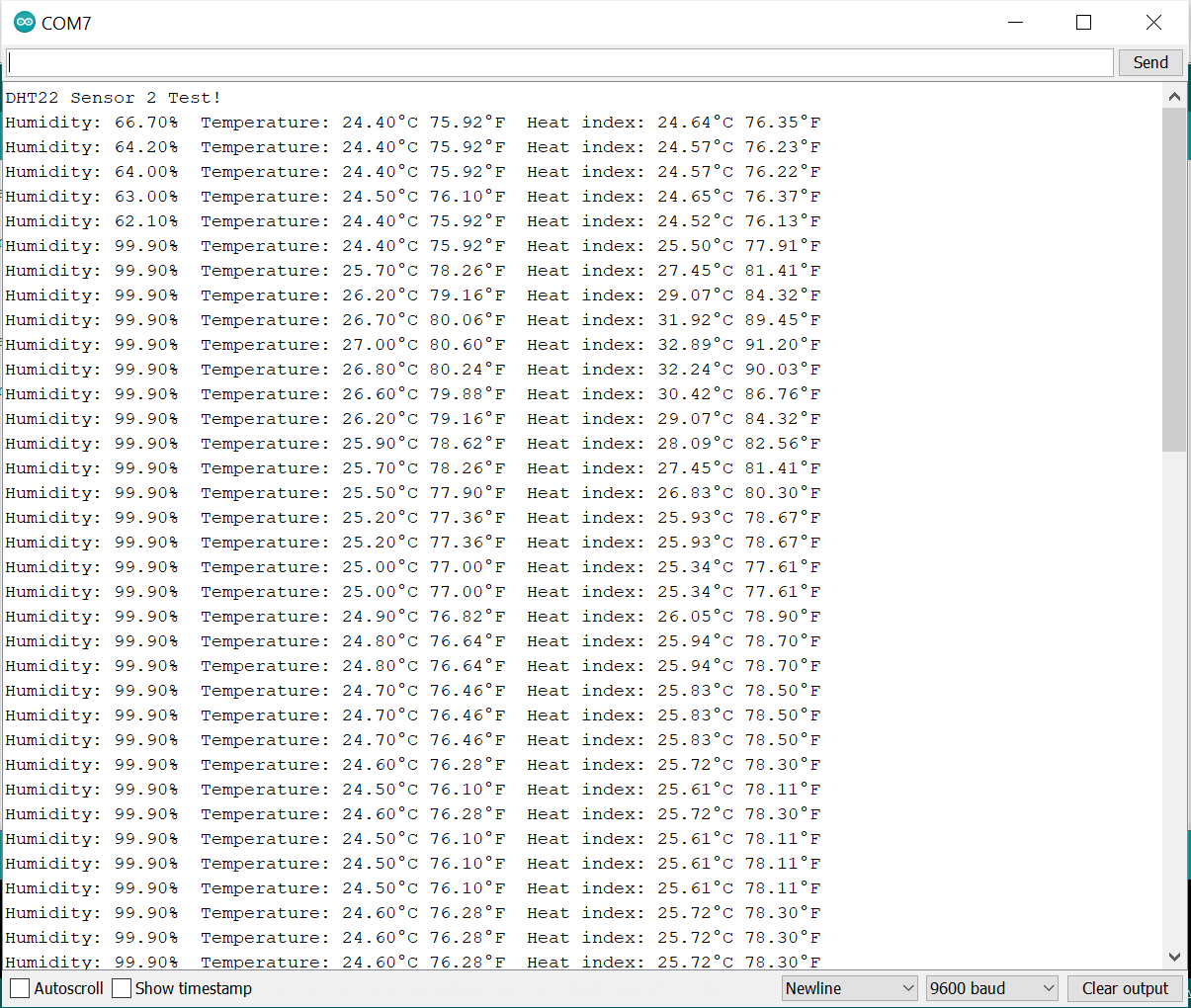
Testing Sensor 2
Ambient Temperature
Begin blowing hot air
Stop blowing hot air

Slide 12
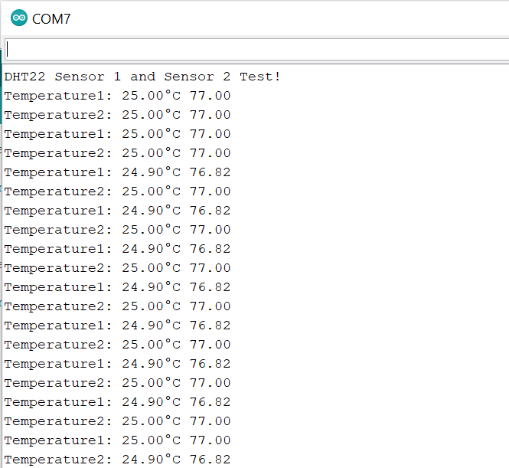
Testing Both Sensors
Difference of 0.1°C

Slide 13
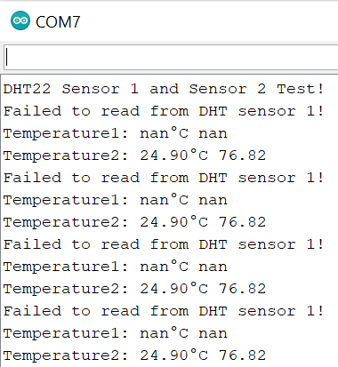
Error Message

Slide 14
VAC Subsystem
Yarentzy Magallanes
Accomplishments since last presentation | Ongoing progress
Determined method of communication between VAC and MCU Purchased IR emitting LED and IR receiver | Decode IR signals being sent by the VAC remote control Mimic IR signals with Arduino using the IR emitting LED
Notes:
When it comes to the air conditioning unit itself I have chosen the model, Determined the best places for it to be located in the vehicle, and determined the method of exaust. This will be better illustrated in the following slide.
My next steps include establishing communication of the MCU and the air conditioning to gain functionality such as turning it on or off, as well as setting the output temperature.

Slide 15
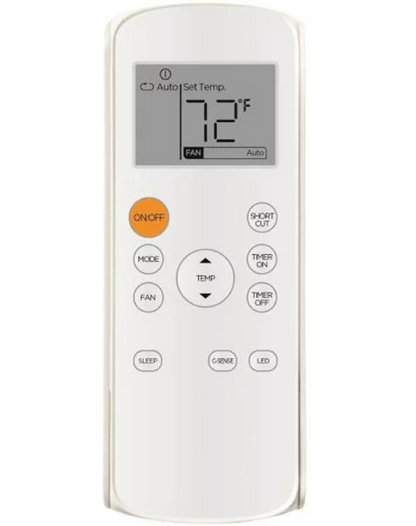
Communication Method
Remote sends different infrared light flashes for each button
Decode that signal
Replicate with Arduino and IR emitting LED

Slide 16
App and Modem
Martin Rennaker
Accomplishments since last presentation | Ongoing progress
Finalized notifications in app, all that is needed is proper message from mcu Configured modem to work with 5V instead of 3.3V | Work on integration with MCU by sending at commands to the modem

Slide 17
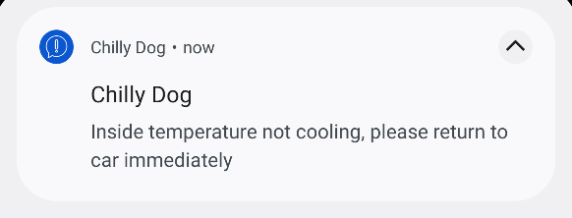
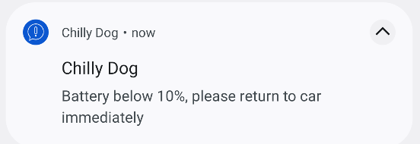
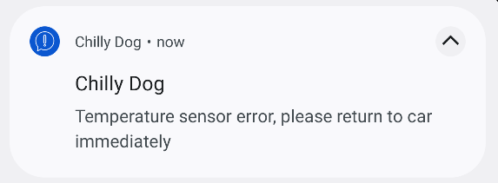
Notification Example

Slide 18
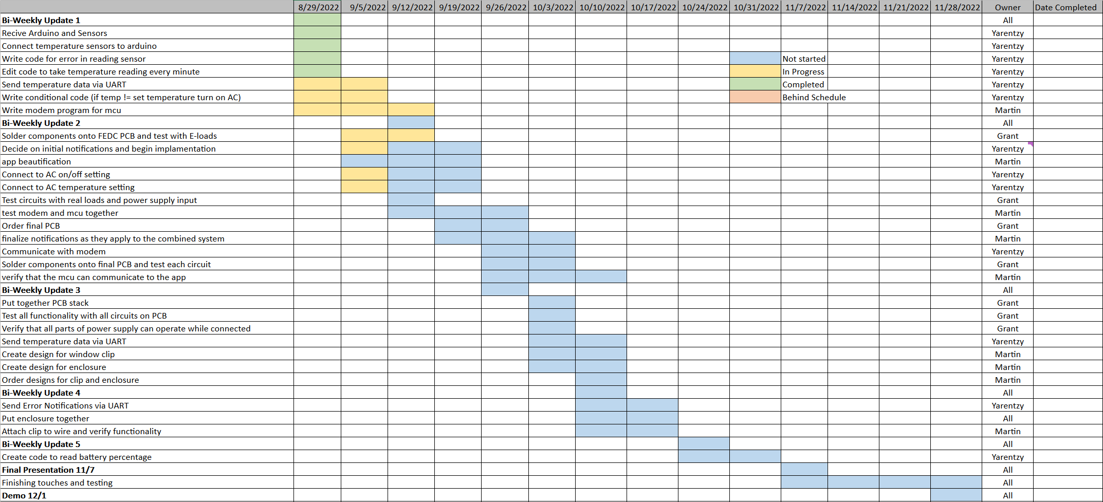
Execution Plan
Notes:
Michelle

Slide 19
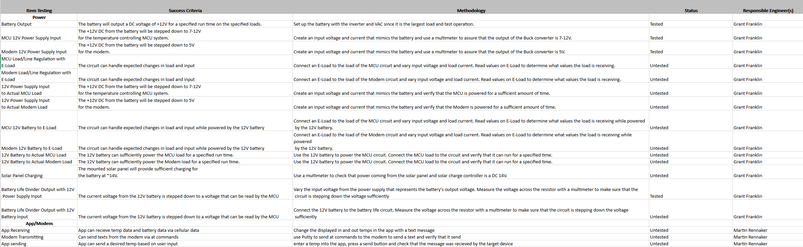
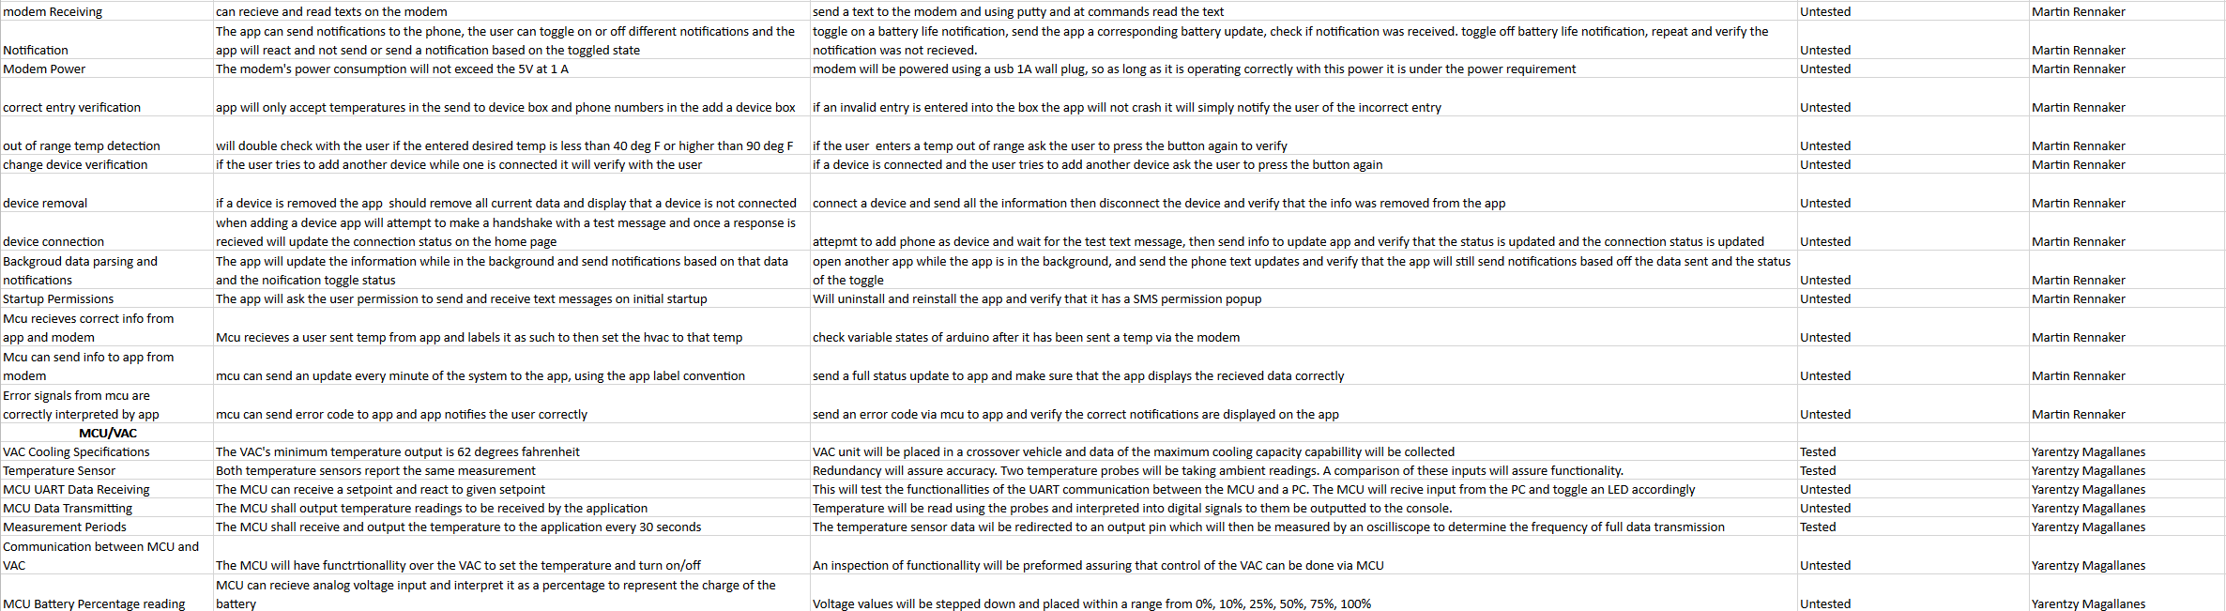
Validation Plan
Notes:
Michelle

Slide 20
Thank you!
Questions?

